Slide 1
Analysis on weather obstruction hampering scoring performance during the 2018 NFL season
Team 8 -
Aaron Hyungbin Woo, Connor Vergara, David Edwards

Slide 2



Methodology:
Xx%
Objective:
A total of XXX games were analyzed to uncover patterns between NFL team performance during varying weather changes for the past two football seasons
Would temperature affect scoring, run/pass ratio, fumbles, or dropped passes.
Does wind speed affect kicking percentage, and run/pass ratio
Would precipitation affect fumbles, dropped passes, and run/pass ratio.
Goal:
Our goal is to confirm or deny the old adage of weather affecting scoring performance.
This will involve using Google API, Dark Sky API, and MySportsFeeds API to coordinates, game results and weather outcomes for each game day.
Does sun/cloud intensity affect percentage of dropped passes.

Slide 3
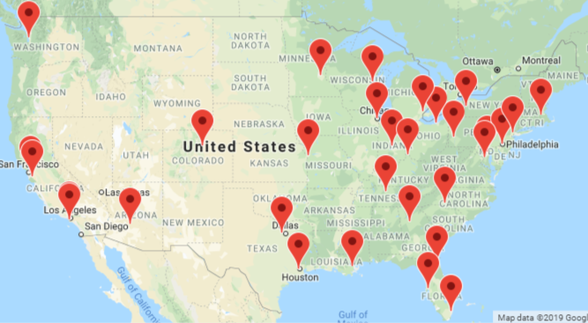
Map of Stadiums
Stadiums
Arrowhead Stadium | Lucas Oil Stadium
AT&T Stadium | M&T Bank Stadium
Bank of America Stadium | Mercedes-Benz Stadium
Broncos Stadium at Mile High | Mercedes-Benz Superdome
CenturyLink Field | MetLife Stadium
Dignity Health Sports Park | New Era Field
FedEx Field | Nissan Stadium
FirstEnergy Stadium | NRG Stadium
Ford Field | Oakland-Alameda County Coliseum
Gillette Stadium | Paul Brown Stadium
Hard Rock Stadium | Raymond James Stadium
Heinz Field | Soldier Field
Lambeau Field | State Farm Stadium
Levi's Stadium | TIAA Bank Field
Lincoln Financial Field | US Bank Stadium
Los Angeles Memorial Coliseum | Wembley Stadium

Slide 4
Data Clean up & Exploration

Slide 5
Data analysis

Slide 6
Open vs Closed Stadium Results
Open Stadium
Closed Stadiums
Xx
Xx
Touchdowns
75%
20%
Field Runs
35%
40%
Interception
50%
80%
Xx
65%
40%
Xx
50%
55%
Xx
45%
65%

Slide 7
Imported Chart
Xx
Xx
Xx
Xx
Your Chart Here
Xx
Xx
Xx
Xx

Slide 8
Line Graph Layout

Slide 9
Multi Pie Graph Layout
Weather comparison between team/stadium
Xx
Xx
Xx
Xx

Slide 10
Bar Graph Layout
Score comparison based on weather.
Xx
Xx
Xx

Slide 11
Multi Pie Graph Layout
Weather comparison between team/stadium
Xx
Xx
Xx
Xx

Slide 12
Slider Layout
Xx%
70.2%
39.87%
24.93%
55.70%

Slide 13
Radial pie graph 1
100%
XX
100%
XX
100%
XX
100%
XX
100%
XX
100%
XX
100%
XX
100%
XX
100%
XX
100%
XX

Slide 14
Radial pie graph 2
100%
XX
100%
XX
100%
XX
100%
XX
100%
XX
100%
XX
100%
XX
100%
XX
100%
XX
100%
XX
100%
XX
100%
XX
100%
XX
100%
XX
100%
XX
100%
XX
100%
XX
100%
XX
100%
XX
100%
XX
100%
XX

Slide 15
Overall Findings

Slide 16
Difficulties, and additional questions

Slide 17

Icons

Slide 18
End Page
Team 8
Aaron Hyungbin Woo Connor Vergara David Edwards

Slide 19
Q & A

